Slide 1


Welcome & Intros
Lead 1
Lead 3
Title
Title
Lead 2
Lead 4
Title
Title

Slide 2
-- insert hack name -- Kick-off
What The Hack?!
-- insert date --

Slide 3
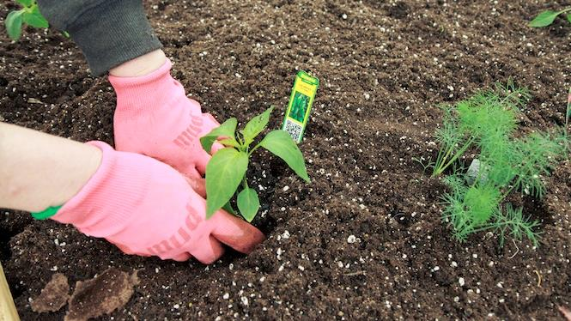
You will get your hands dirty
Notes:
You only get out what you put in, don't be lazy.
Knowledge Retention through Pain and Discomfort

Slide 4
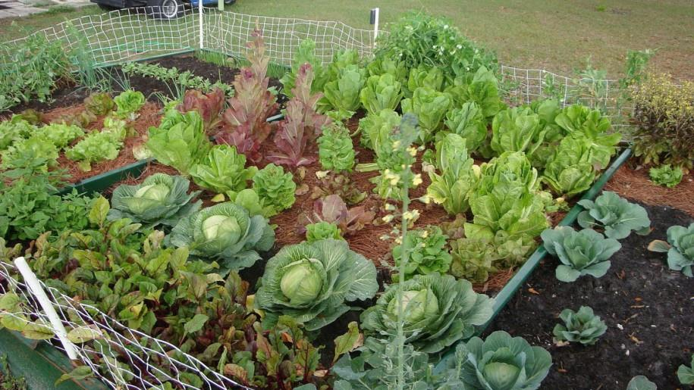
*results may vary
Notes:
You might not grow a garden like this… but at least you can learn while trying.

Slide 5

Logistics
Notes:
And now we’ll cover logistics…

Slide 6
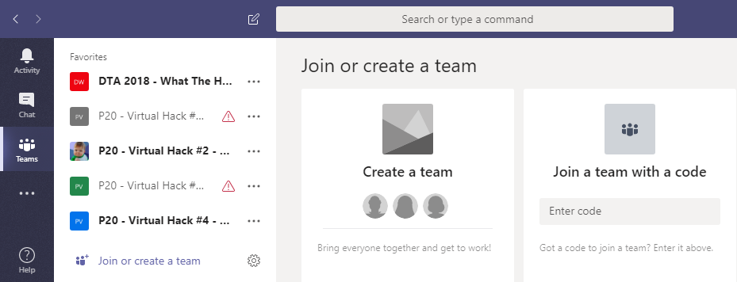
Collaboration
Step 1: Join the Team!
Team: “-- insert Teams team name here --”
Join Code: “-- join code here --”
#2
#1
-- join code --

Slide 7
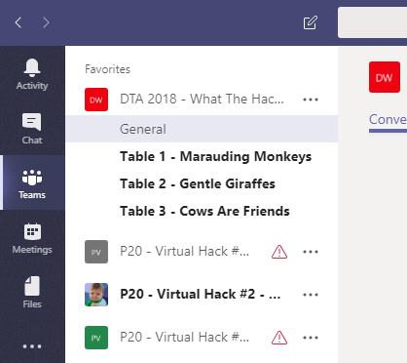
Collaboration
Step 2: Create a Channel for your table’s team!
Name your team something unique and fun, but prefix with your table #!
Team: “-- insert Teams team name here --”
Join Code: “-- join code --”

Slide 8
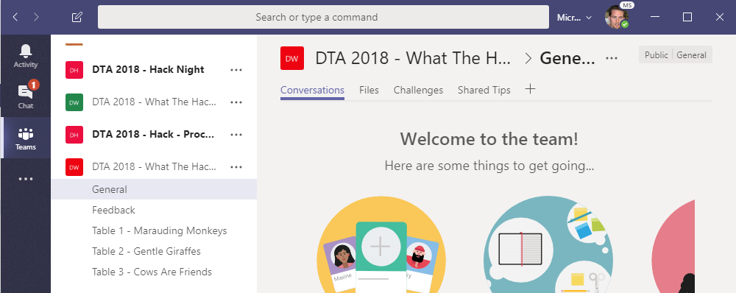
Collaboration
Step 3: Collaborate!
-- join code --
Hang out, communicate, talk, and screenshare with squad members in your squad’s channel
DURING & after the event, share feedback with the proctors in the Feedback channel. This will help them improve the event as it progresses and make the next one even better
Find any files, resources, or code samples, and THIS presentation here!
Challenges will be posted here by the proctors throughout the event
Share tips, tricks, gotchas (how you solved them), code snippets, and links you learn along the way here with everyone

Slide 9
-- join code --
Format
Challenges are cumulative, building upon each other.
Establish Confidence – start small and simple (think hello world)
Build Competence – by having successively more complex challenges
Challenges are NOT step-by-step hands on labs!
No “clicking here” or “copy n pasting there”
Challenge definitions are short. A couple of sentences or bullet points stating the end goal(s) and perhaps a hint at the skill(s) needed.
You MUST work together as a team to figure out how to complete them!

Slide 10
-- join code --
Format
For each challenge we will deliver a ”mini-lecture” explaining concepts in it.
We’ll review results for each challenge when it looks like a majority of folks have completed the challenge
Don’t be beholden by the clock!
Move quickly or take it slow.
Your proctors are here to help you.
There WILL be more challenges than you can complete in our allotted time!
These are takeaways for follow up at home or with customers!

Slide 11
-- join code --
Proctors
Each team will have a proctor through-out the whole hack.
Use them! But don’t expect them to give you all the answers.
Get to know your proctor, their likes and dislikes...
All the better to find a bribe that works!
Notes:
Keep the teams working as teams!
Encourage all to “learn from” and “share with” each other!
If you observe individuals racing ahead, encourage them to help those who are behind.
Encourage attendees to use their team’s channel on MS Teams to collaborate/share info!
Unblock teams who get stuck
Encourage team members to unblock each other first!
Provide hints, but not answers
If you observe individuals stuck for a while, help them get moving so they don’t lose interest.
Provide hints/pointers to the teams on how to solve problems & where to find information.
Use the answers/solutions in the proctor’s guide, but don’t share with the attendees
Proctor’s guide won’t be comprehensive. As SMEs, proctors should use their knowledge to help with solution hints/ideas.
Notify the emcee of unexpected blockers that arise during the event so they can be communicated to all, and recorded for future reference.

Slide 12
-- join code --
Tooling
You can use any tooling you want, but we strongly encourage (and will only support the following):
-- insert your list of required tooling here --
-- Eg: Visual Studio Code
-- Eg: Windows Subsystem for Linux with the Azure CLI installed.

Slide 13
-- join code --
Finding Answers
Search engines are your friend! Azure is a hot technology and much ink has been spilled on it.
The Azure docs are your best bet.
Many of the related open source projects used here have top notch documentation!

Slide 14

And now death by Power Point…

Slide 15
And now death by Power Point… (just kidding!)

Slide 16

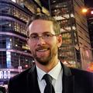
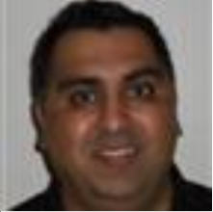
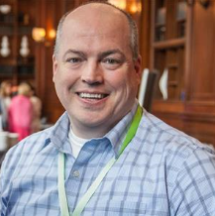

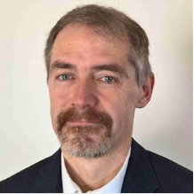
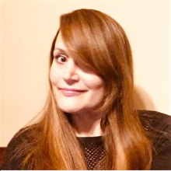

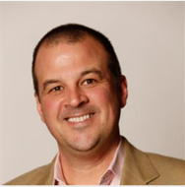
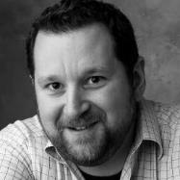
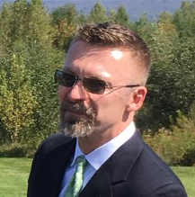
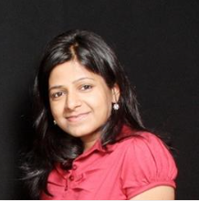
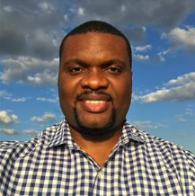



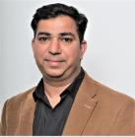
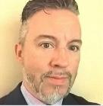

Thank you !!!
Chief Wranglers:
Gino Filicetti and Peter Laudati
DTA What the Hack Contributors:
Kamran Bhurgri, Rich Ross, Ryan Berry, Dave McKinstry
Laura Edell, Diana Phillips,
LT Sponsors:
Chris Hallberg & Tony Surma
Patrick El-Azem, Neelam Gupta
Israel Ekpo, Sowmyan Chullikkattil, Peter Laudati, Gino Filicetti
Todd Van Nurden, Gaurav Hind, Jeff Fattic, Jeff Lear

